Slide 1

Analyzing Home vs. Away Performance in the NFL
Presented by: Paul Florio
This Photo by Unknown Author is licensed under CC BY

Slide 2
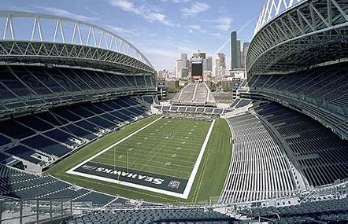
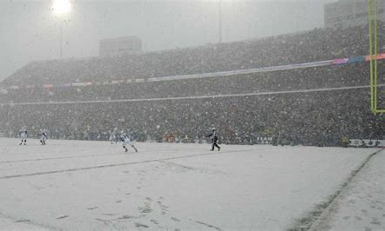
Quick Background Information
Does “Home-Field Advantage” still hold true in the modern NFL?
“Home-Field Advantage” is a term used in every sport
Impacts each sport separately
Impact on NFL Games
Travel
Ex: Playing on the East Coast as a West Coast team
Weather
Ex: Indoors vs Outdoors, Cold vs. Warm Weather
Game Noise on Offense and Defense
Communication between players and coaches

Slide 3
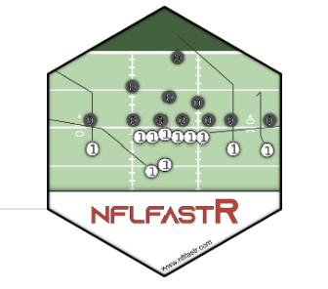
Data Source
Data Source: NFL Fast R (www.nflfastr.com)
R package containing game data since the 1999 season
Points Scored, Points Allowed, Game Date/Type, Betting Odds
Focus on 2024 season
Difference in points scored/allowed in home vs away games per team
Win Percentage (Do certain teams play better at home or away)

Slide 4
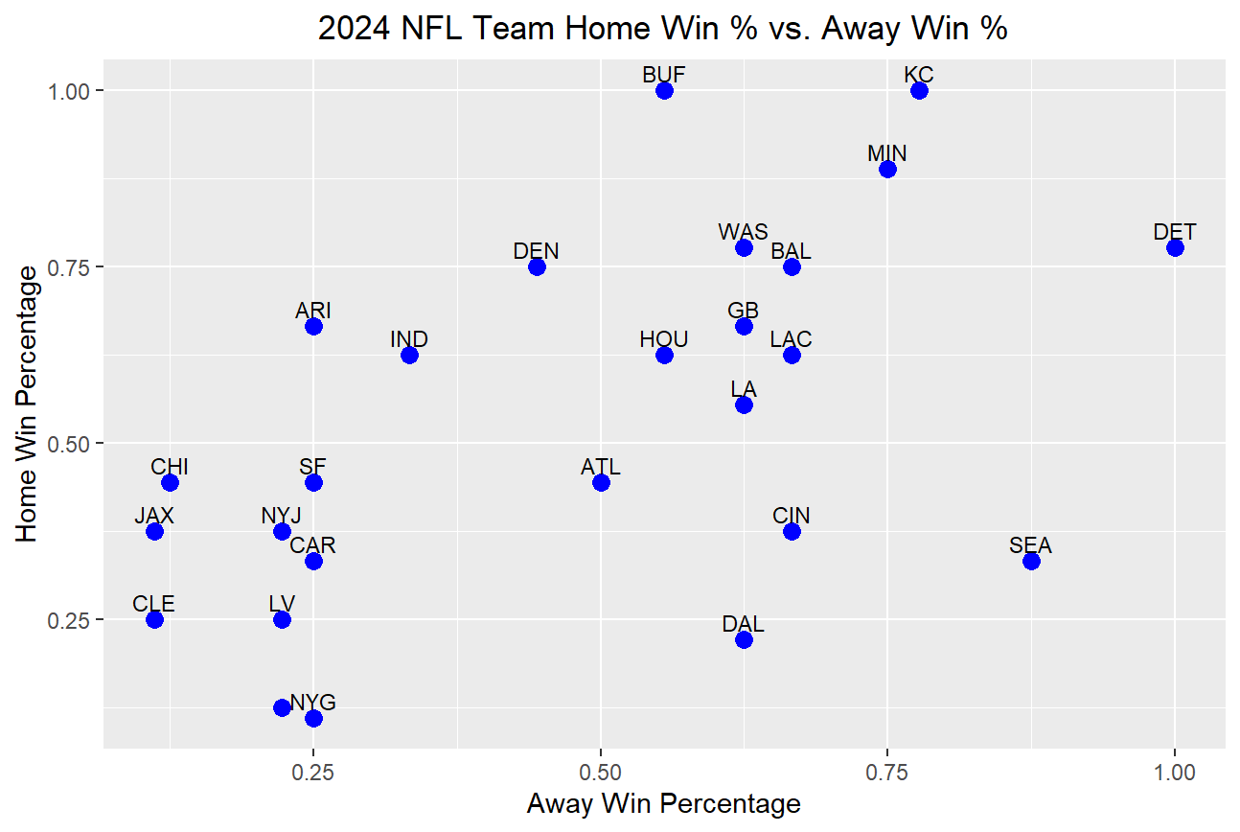
Overall Win Percentage
Good Home
Bad Away
Created scatterplot to identify any outliers
Ignore teams with ~= win % at home and away
Great teams can win in any environment
Horrible teams will lose in any environment
Two main types of outliers:
Top Left – Teams that win at home more often
Bottom Right – Teams that lose at home more often
Key Takeaways:
Top Left and Bottom Right boxes are equal
No significant sign of majority of teams being home winners
Good Teams
Bad Teams
Bad Home
Good Away

Slide 5
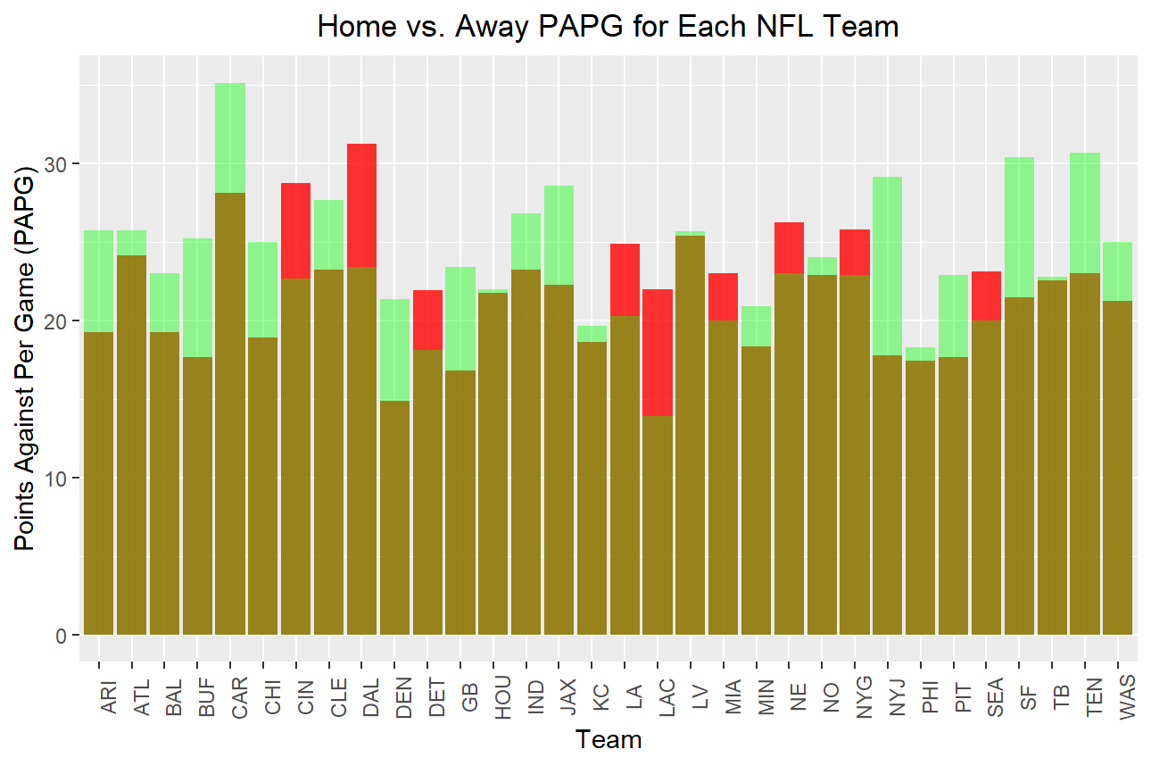
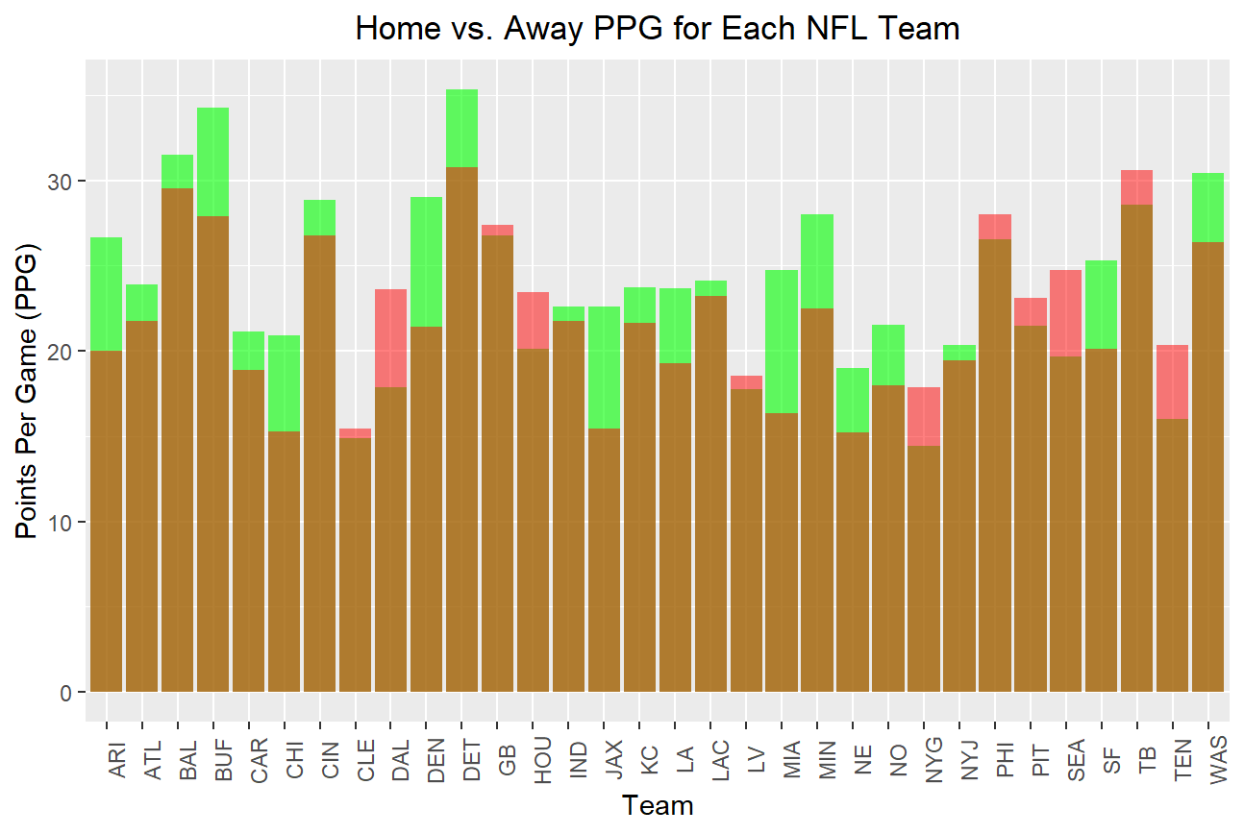
Offense + Defense Performance Impacts
Created bar plots to depict the advantage or disadvantage
Green = Better home metric (More points scored or Fewer points allowed)
Examples:
Miami – Better Offense at home but worse Defense (Higher Scoring Home Games)
Los Angeles – Both teams underperformed significantly at home
Known for drawing large away crowds

Slide 6
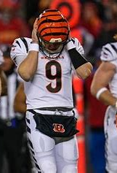
Data Impacts
Playoffs
Teams with best records in each conference receive “Home-Field Advantage” for playoffs
Analyzing whether this helps the best teams
Coaches
Preparing for an opponent knowing that they are better in one situation or another
Can affect plays called by the coaches and change the overall team strategy
Bettors
Often a home team is favored by a few points more because of being the home team
Either helps the sports books set fairer lines or helps bettors invest in better than advertised lines
Schedule Makers
Attempting to balance team schedules
Avoid forcing teams to be at other disadvantages knowingly ahead of the game

Slide 7
Takeaways + Future Research
Home-Field Advantage has very minimal performance impact
Still advantageous to be home
Future Research:
Comparison to other seasons
Are certain teams naturally “home advantageous teams”?
Playoff only impacts (Compare with regular season)
External Factors
Weather Impact
Altitude (Miami vs. Denver)
Time between games/Travel

